Slide 1
PNSol:
the network performance science company.
Evaluation Task
By Irina White

Slide 2


Task overview:
Dataset 1: synthetic network conditions are time-stationary. Consider various aspects of the 𝚫Q and extract properties of the CDFs.
Q: What conclusions can you make about this data. What is the possible real-world reason for the missing values at certain times?
Dataset 2: synthetic network conditions are piecewise time-stationary and represent varying network path properties.
Q: Can you detect the boundary between the piecewise changes? Can you make comments on the different conditions being captured?

Slide 3
Presentation Agenda
Delay/Loss
over time
+
Observation
Delay/Loss
with respect to packet size
+
Observation
Further statistical analysis: CDF
+
Observation
Conclusion
Limitations

Slide 4
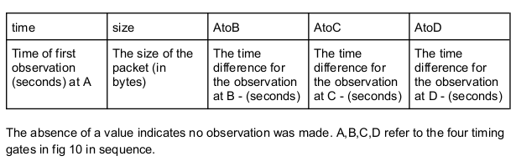
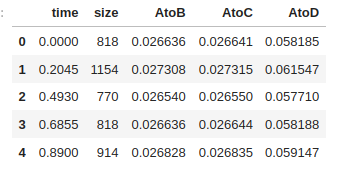
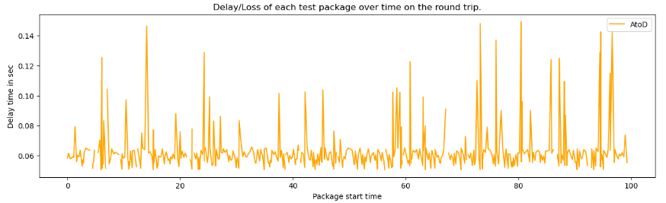
Dataset 1: time - stationary

Slide 5
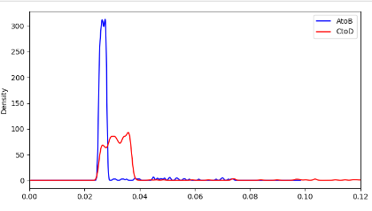
PART I
Engineered values of delays/losses between observation points AtoB. BtoC, CtoD.
The distribution of observations between point, excluding BtoC is below.
Observation:
Slightly right skewed distribution: tail signifies that there are packets that take way longer than average to be transmitted;
AtoB distribution of a small variance; while CtoD is more spread out;
Average 𝚫Q on AtoB is 0.0283 vs. 𝚫Q on CtoD 0.0342 (21% increase).

Slide 6
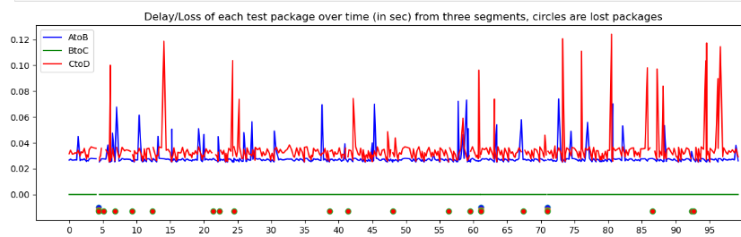
PART I (continued): isolated rows with NA data points.
Observation:
There is a higher number of dropped packets (19/500 = 3.8 %) vs (3/500 = 0.6%) in AtoB and CtoD sections.
Loss of three packages on the section AtoB can possibly be related to network load/congestion and scheduling/buffering ( 𝚫Q _{| V}).
Loss of other 16 packets on the section CtoD can possibly be related to similar variable delay due to its’ time-stationary appearance.

Slide 7
Python Code sample:
# import libraries
# download provided dataset
# use matplotlib and seaborn to plot graphs
…
# create new data points (data between observation points)
data['BtoC']=data['AtoC']-data['AtoB']
data['CtoD']=data['AtoD']-data['AtoC']
stat=round(data[['AtoB','BtoC','CtoD']].describe(),4)
…
# obtain all NA values in the dataset
data_na=data[data.isna().any(axis=1)]
# create visual representation of the lost packets along with all three sections of packet transmission data
… # replace null values with -0.01, - 0.012, -0.013 to show them on the plot along with the other data.
data_naAB.fillna(-0.01, inplace=True) ; data_naBC.fillna(-0.012, inplace=True); data_naCD.fillna(-0.013, inplace=True)
…
plt.plot(data['time'], data['AtoB'], color='blue', label='AtoB')
plt.plot(data['time'], data['BtoC'], color='green', label='BtoC')
plt.plot(data['time'], data['CtoD'], color='red', label='CtoD')
plt.plot(data_naAB['time'], data_naAB['AtoB'], linestyle='None', marker="o", markerfacecolor="blue")
plt.plot(data_naBC['time'], data_naBC['BtoC'], linestyle='None', marker="o", markerfacecolor="green")
plt.plot(data_naCD['time'], data_naCD['CtoD'], linestyle='None', marker="o", markerfacecolor="red")

Slide 8
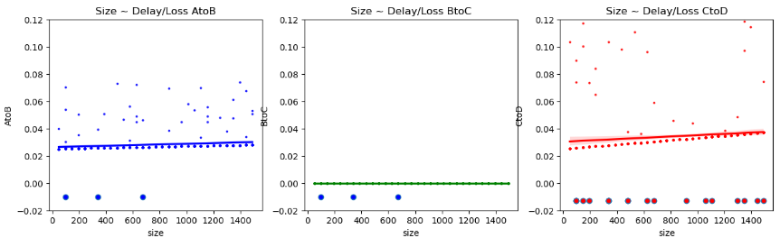
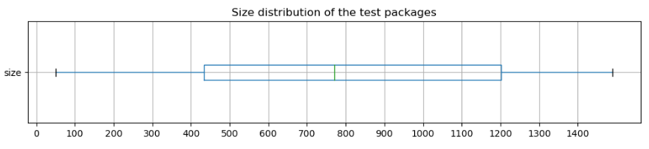
PART II: Delay/Loss overview with respect to package size.

Slide 9
Observation:
Sizes of the packets are well-distributed.
Line of best fit: AtoB: slope 2.43 x 10⁻⁰⁶ and y_{int} 0.026 ; CtoD: slope 4.77 x 10⁻⁰⁶ and y_{int} 0.030: miniscule positive correlation.
While three outbound dropped packages are highly likely due to the variable delay 𝚫Q : congestion/ upstream traffic.
Additional 16 packages were dropped with incoming traffic/ downstream. Possible issues:
congestion: full queue on the customer's router
dropped connection due to port problem / access node (equipment)?
smaller buffers on customer side or OS is too busy handle them in time
most likely it is 𝚫Q _{|v}, however 𝚫Q_{|s} might be an option.
Average loss rate or delay/length on CtoD: 0.0429ms/bite

Slide 10
Python Code sample:
# plot size distribution of the test packets using boxplot
data.boxplot(column='size', figsize=(4, 3), vert=False)
# using seaborn library to plot linear regression of data points and plot NA values
sns.regplot(x='size', y='AtoB', data=data, color='blue', scatter_kws={'s':3})
plt.plot(data_naAB['size'], data_naAB['AtoB'], linestyle='None', marker="o", markerfacecolor="blue")
#calculate data for the linear regression line:
data_no_na=data.dropna(axis= 0, how='any')
from scipy import stats
slopeAB, interceptAB, r_value, p_value, std_err = stats.linregress(data_no_na['size'], data_no_na['AtoB'])
slopeCD, interceptCD, r_value, p_value, std_err = stats.linregress(data_no_na['size'], data_no_na['CtoD'])
print(f"Line of best fit for AtoB: slope {slopeAB} and y-intercept {interceptAB} \n \n\
Line of best fit for CtoD: slope {slopeCD} and y-intercept {interceptCD}")

Slide 11
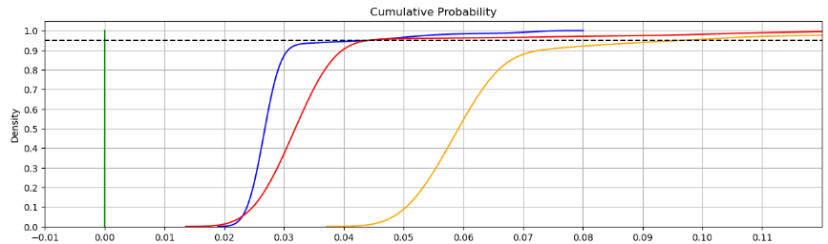
PART III: CDF likelihood of occurrence
Observation:
AtoB: 50% of the delays last for less than ~26ms, while 95% of the delays are less than ~45ms for packages up to 1.5kBit.
CtoD: 50% of the delays last for less than ~34ms, while 95% of the delays are less than ~48ms.
AtoD: 50% of the delays last for less than ~60ms, while 95% of the delays are less than ~94ms.

Slide 12
Python Code sample:
#Likelihood of occurrence of each delay/loss.
# KDE plot : kernel density estimation (KDE) is a non-parametric way to estimate the probability density function (PDF) of # a random variable
fig, ax = plt.subplots(figsize=[15,4])
ax.get_title(loc="center")
ax.set_title('Cumulative Probability')
sns.kdeplot(data = data['AtoB'], cumulative = True, label = 'AtoB', color='blue')
sns.kdeplot(data = data['BtoC'], cumulative = True, label = 'BtoC', color='green')
sns.kdeplot(data = data['CtoD'], cumulative = True, label = 'CtoD', color='red')
sns.kdeplot(data = data['AtoD'], cumulative = True, label = 'AtoD', color='orange')
plt.axhline(y=0.95, color='black', ls='--')
ax.set_xlim(0, 0.12)
ax.set_xticks(np.arange(-0.01, 0.12, 0.01))
ax.set_yticks(np.arange(0, 1.1, 0.1))
plt.grid()
plt.show()

Slide 13
Dataset 2

Slide 14
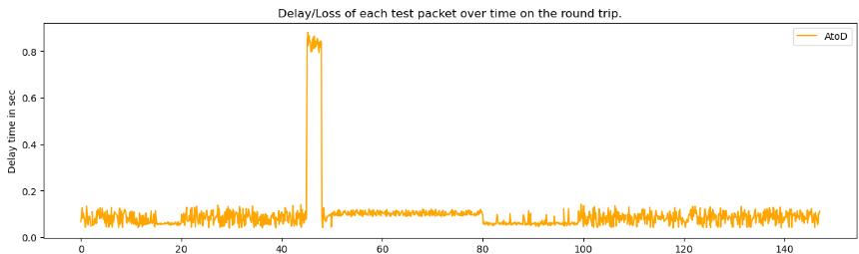
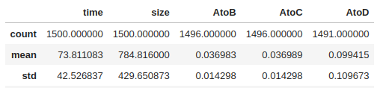
Dataset 2: piecewise time - stationary

Slide 15
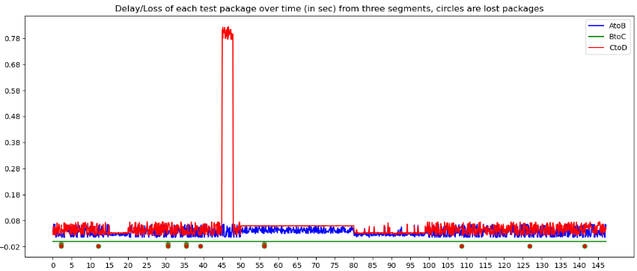
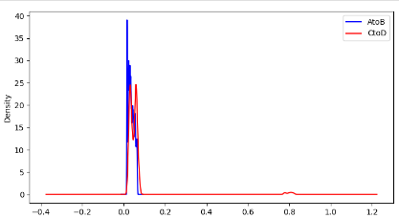
PART I: data split into three segments and NA values isolated

Slide 16
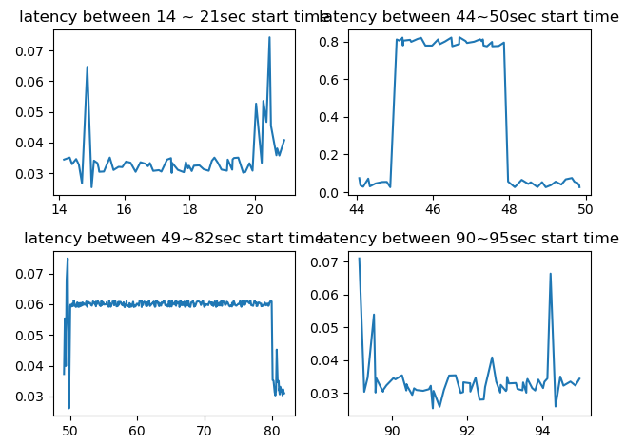
PART I (cont): Four sections: 15~20sec, 45~47sec, 47~80sec, 80~100sec time-marks are required deeper analysis

Slide 17
Observation:
the second dataset clearly represents more stationary time series (does not have clear trend, the variance is almost constant over time) especially for AtoB segment.
the represenation of the segments shows that the piecewise component is added by the CtoD segment.
Packet loss: 0.27% upstream; 0.33% dowsntream: overall 0.6% packet loss:
AtoB upstream, 4 packets dropped, potentially due to congestion/ ethernet.
CtoD downstream, 5 dropped packets:
15~20sec mark have very little network jitter, straight after a downstream packet loss; can be a minor reset.
45~48sec mark have a high jump in delay: router trouble/ high network congestion; can explain two previously lost downstream packets.
50~80sec mark very stationary/ almost no noise segment: route changed/ router reset/ empty caches, etc.; can explain no packet loss for over 60sec after reset.
Average 𝚫Q for AtoB: 0.037, however vs. CtoD bimodal distribution (because of spike) shows presence of two groups, it is more meaningful to consider two separate means: 0.03 and 0.09

Slide 18
Code sample that wasn’t used in dataset1:
#Four sections: 15~20sec, 45~47sec, 47~80sec, 80~100sec time-marks are required deeper analysis:
fig, axs = plt.subplots(2, 2)
axs[0, 0].plot('time', 'CtoD', data= data.loc[(data['time'] >= 14) & (data['time'] <= 21)])
axs[0, 0].set_title("latency between 14 ~ 21sec start time")
axs[0, 1].plot('time', 'CtoD', data=data.loc[(data['time'] >= 44) & (data['time'] <= 50)] )
axs[0, 1].set_title("latency between 44~50sec start time")
axs[1, 0].plot('time', 'CtoD', data=data.loc[(data['time'] >= 49) & (data['time'] <= 82)] )
axs[1, 0].set_title("latency between 49~82sec start time")
axs[1, 1].plot('time', 'CtoD', data= data.loc[(data['time'] >= 89) & (data['time'] <= 95)])
axs[1, 1].set_title("latency between 90~95sec start time")
fig.tight_layout()

Slide 19
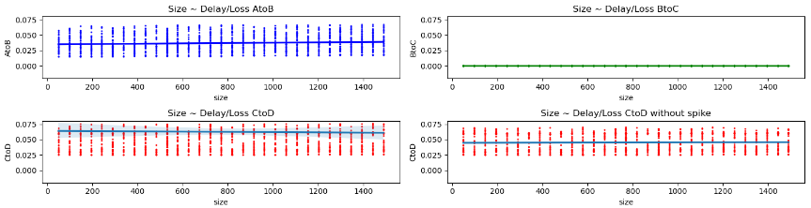
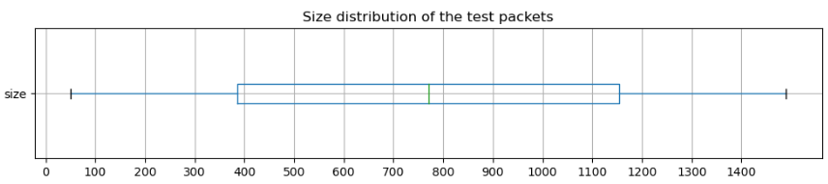
PART II: Delay/Loss overview with respect to package size.

Slide 20
Observation:
Line of best fit: AtoB: slope 2.75 x 10⁻⁰⁶ y_{int} 0.035; CtoD: slope -2.05 x 10⁻⁶ and y_{int} 0.064
Packet sizes are well distributed.
The visualisation of the delay/loss with respect to the packet size shows almost no effect the size is having on the delay/loss. Especially if one is to exclude the spike piece.
Loss of three upstream packets are likely due to the variable delay 𝚫Q _{|V}: congestion.
Segment CtoD: the slope of the regression line is small, yet negative. Most likely it signifies 𝚫Q_{|G} geographic delay: physical layer transmission component; which can be the cause of additional 5 packets loss.

Slide 21
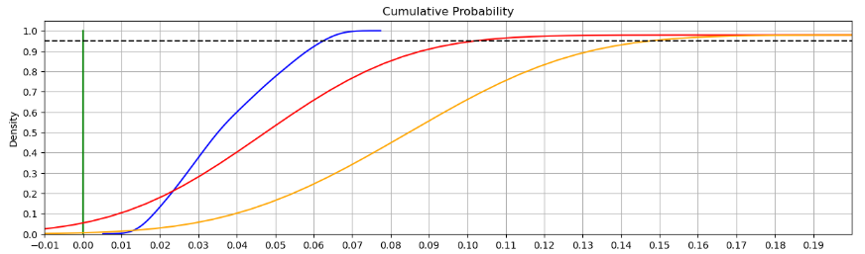
PART III: CDF likelihood of occurrence
Observation:
AtoB: 50% of the delays last for less than ~35ms, while 95% of the delays are less than ~60ms for packages up to 1.5kBit.
CtoD: 50% of the delays last for less than ~47ms, while 95% of the delays are less than ~100ms.
AtoD: 50% of the delays last for less than ~85ms, while 95% of the delays are less than ~150ms.

Slide 22
Conclusion
Dataset 1 (variable/ serialisation)
While performance on the separate segments seems to show acceptable results, the situation is mostly affected by CtoD segment performance,downstream. The issue is most likely related to the variable delay 𝚫Q_{|V}: buffering, congestion, load. The worrisome issue here is the loss packet rate: 3.8%, the reason can be overloaded network devices.
Dataset 2 (variable / geographic)
The situation is mostly affected by downstream performance. While upstream and server response is in the acceptable delay/loss range, the downstream situation is slightly different. The performance has solid results after the reset (45~48sec) for about 30sec, however the network jitter returned back after that with the loss of three packets. It is possible that the physical component is at fault and maybe should be replaced to maintain more stable level of performance.
Limitations
Knowledge of the prior network performance if available:
- recurring issues;
- hardware;
Deeper understanding of the computer network operation

Slide 23
Thank You!

